Slide 1

An Efficient and Fast Active Contour Model for Salient Object Detection
Authors:
Farnaz Shariat ,
Riadh Ksantini,
Boubakeur Boufama
shariatf@uwindsor.ca
ksantini@uwindsor.ca
boufama@uwindsor.ca
University of Windsor
May 2009

Slide 2
Presentation Outline
Introduction
  Active contours
  Level sets
A variational level set method
Polarity information
The active contour model using polarity information
Experiments

Slide 3
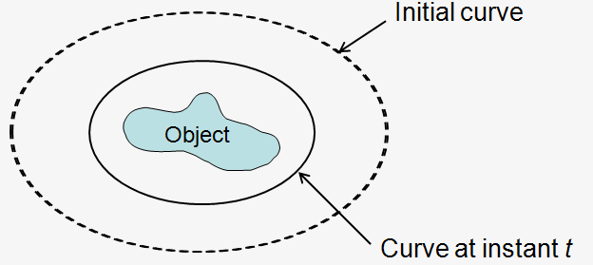
Active Contours
Image Segmentation solution
Based on Deformable models
Find equation
Parametric Represent curves and surfaces explicitly in their parametric forms during deformation; (Kass 1987 )
Geometric Based on curve evolution and the level set method, Represent curves and surfaces implicitly as a level set of a function; (Caselles 1993)

Slide 4
Active Contours(cont’d)
limitations of parametric AC
  Initial contour dependant
  Same topology
Geometric ACs provide elegant solution
  Based on level set , curve evolution

Slide 5
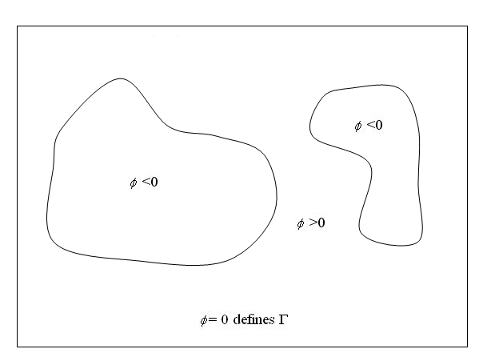
Level sets
Main Idea:
  Closed interface Γ, velocity v
  Goal: motion of the interface
Osher and Sethian1988 idea:
  Represent the interface by implicit smooth function φ
    φ =(x, t) =0 , Γ
    φ =(x, t) <0 , Γ_{in}
    φ =(x, t) >0 , Γ_{out}

Slide 6
Level sets(cont’d)
Remains a valid function change topology
Computationally simple
Start far from boundaries

Slide 7
Level sets (cont’d)
originated from minimizing the energy function
originated from a certain evolution PDE of a parameterized curve
Classical vs. Variational
Variational methods are suitable for incorporating additional information

Slide 8
Level sets (cont’d)
Reshaping (re-initialization)
  φ can develop shocks inaccurate computation
  To avoid
    Initialize φ as a signed distance function
    Reshape φ as a signed distance function regularly
  Drawbacks
      Displacement of the zero level set
      Increasing of the number of iteration
      Expensive, Complex
      Ad hoc manner

Slide 9



Variational level set
C. Li, C. Xu, C. Gu, M.D. Fox, “Level set evolution without re-initialization: a new variational formulation”, CVPR, 2005
Energy function :
Keeping the function close to sign distance function
Moving toward the boundaries

Slide 10
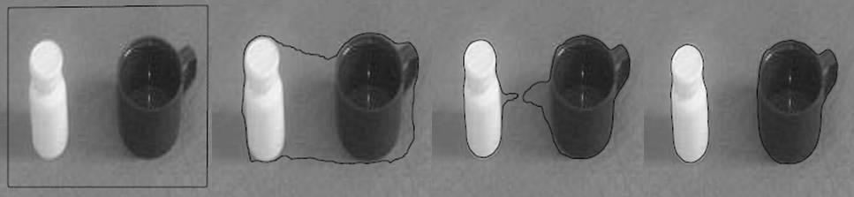
Variational level set (cont‘d)
Advantages
  Initialization is automatic
  No need for reinitialize
  Computationally effective
Active contour result using Li’s algorithm

Slide 11

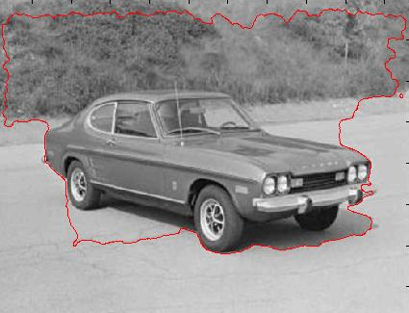

Variational level set (cont‘d)
Problem
  Noisy background
  Textured background
Proposed Solution
  Using “Polarity information” instead of gradient with “Level sets”
Active contour result using Li’s algorithm

Slide 12
Polarity information
Common edge detectors
Polarity [Carson, 1997], discriminates boundaries
  A measure of the extent to which the gradient vectors in a certain neighbourhood all point in the dominant orientation .
#gradient vectors in are in + side of dominant orientation
#gradient vectors in are in - side of dominant orientation

Slide 13
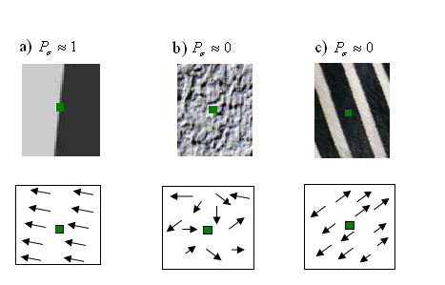
Polarity Values
Noise
Texture
Edge
E₊= E₋
i.e. E₋=0,
E₊!=0
E₊ ~ 0
E₋ ~ 0

Slide 14
The Active Contour Model Using Polarity Information
Instead of Gradient in E_{ext} use Polarity
  Combine “Polarity based stopping function” with “Variational Level Set”

Slide 15





The Active Contour Model Using Polarity Information
The final energy function is

Slide 16



The Active Contour Model Using Polarity Information
Then by using energy minimization method to minimize the total energy it can reach to:
And by using gradient descent, the approximation of the above formula is:

Slide 17
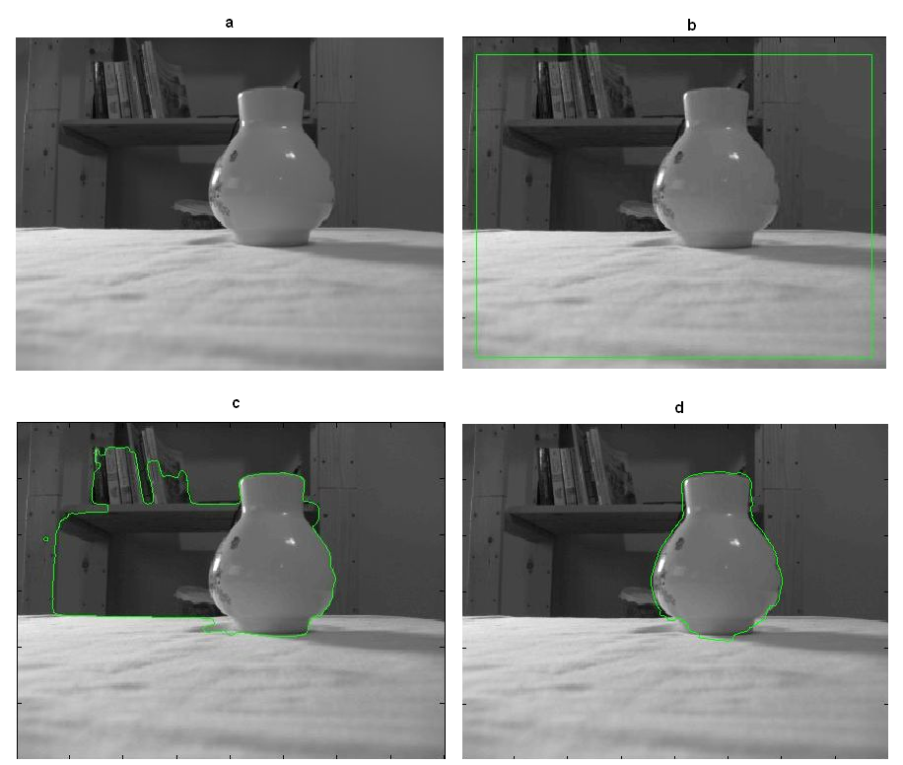
Results

Slide 18
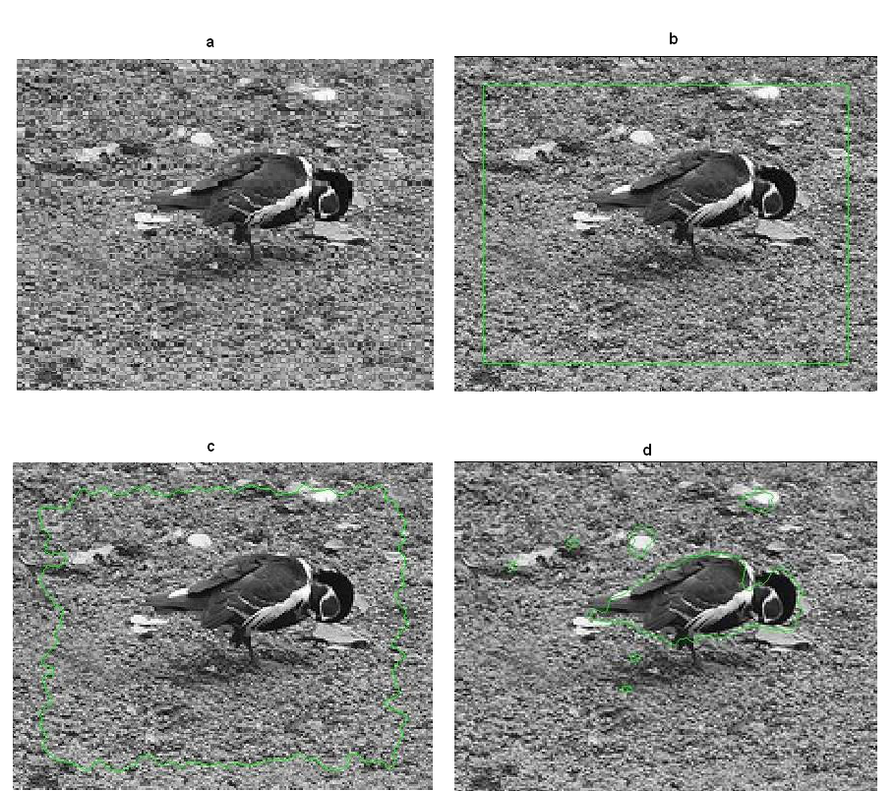
Results

Slide 19
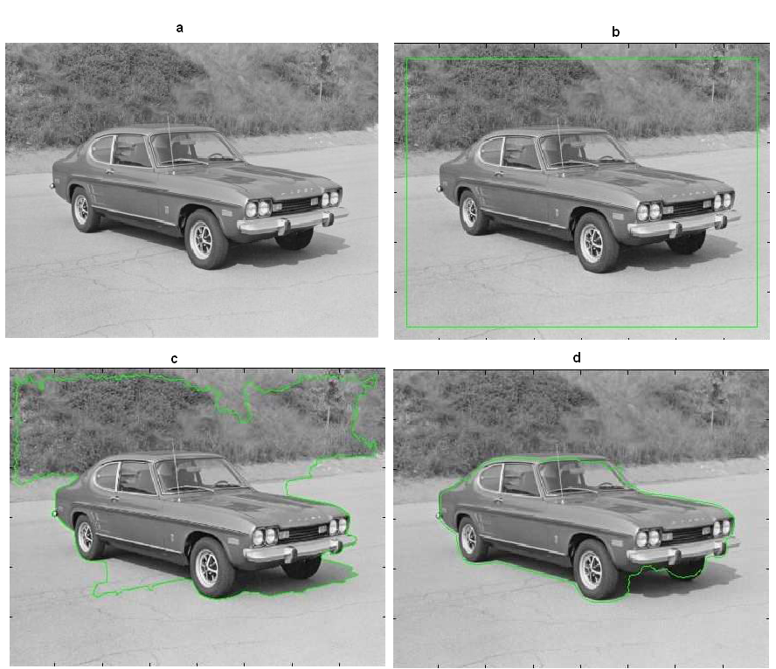
Results

Slide 20
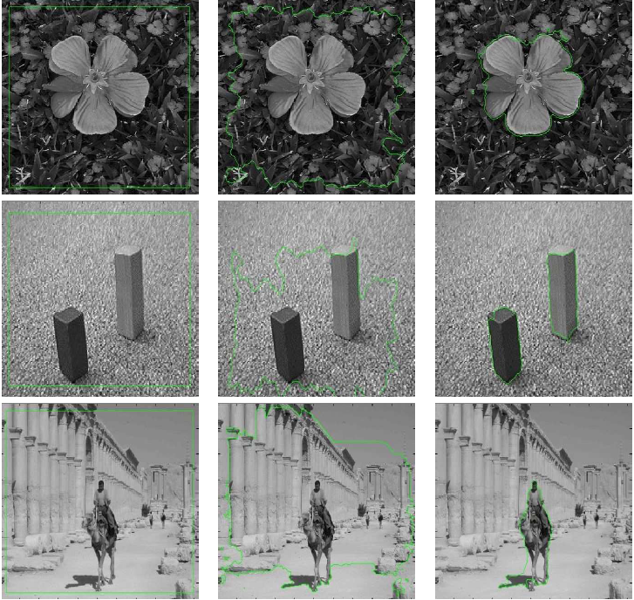
Results

Slide 21
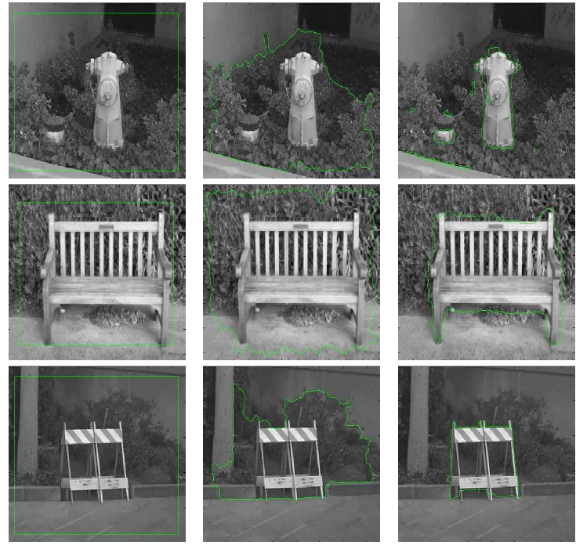
Results

Slide 22

Any
Questions
Thank you for your Attention

