Slide 1
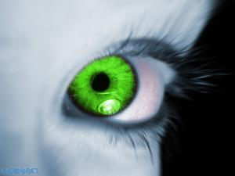
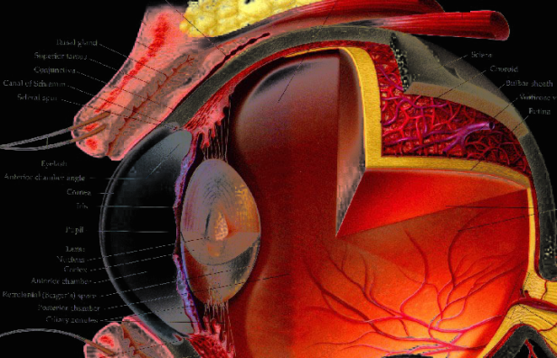
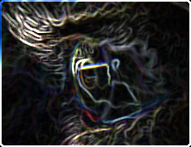
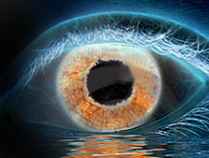
Corneal Layer Extraction
Vision and Image Processing Group
University of Waterloo
Justin Eichel, Akshaya Mishra, Paul Fieguth, David Clausi, Kostadinka Bizheva

Slide 2
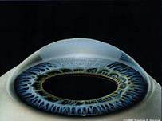
Data Acquisition
UHROCT
  ultra high resolution optical coherence tomography
  47,000 A-scans/s
  3um x 10um (axial x lateral) resolution
Dataset
  Corneal hypoxia study
  2 healthy subjects
  Contact inducted

Slide 3
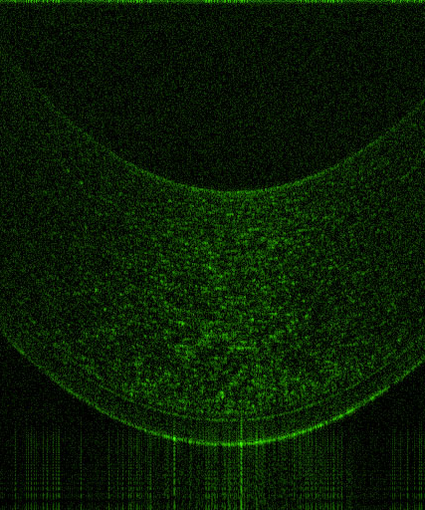
Data Acquisition
Issues
  Low contrast
  Noise

Slide 4
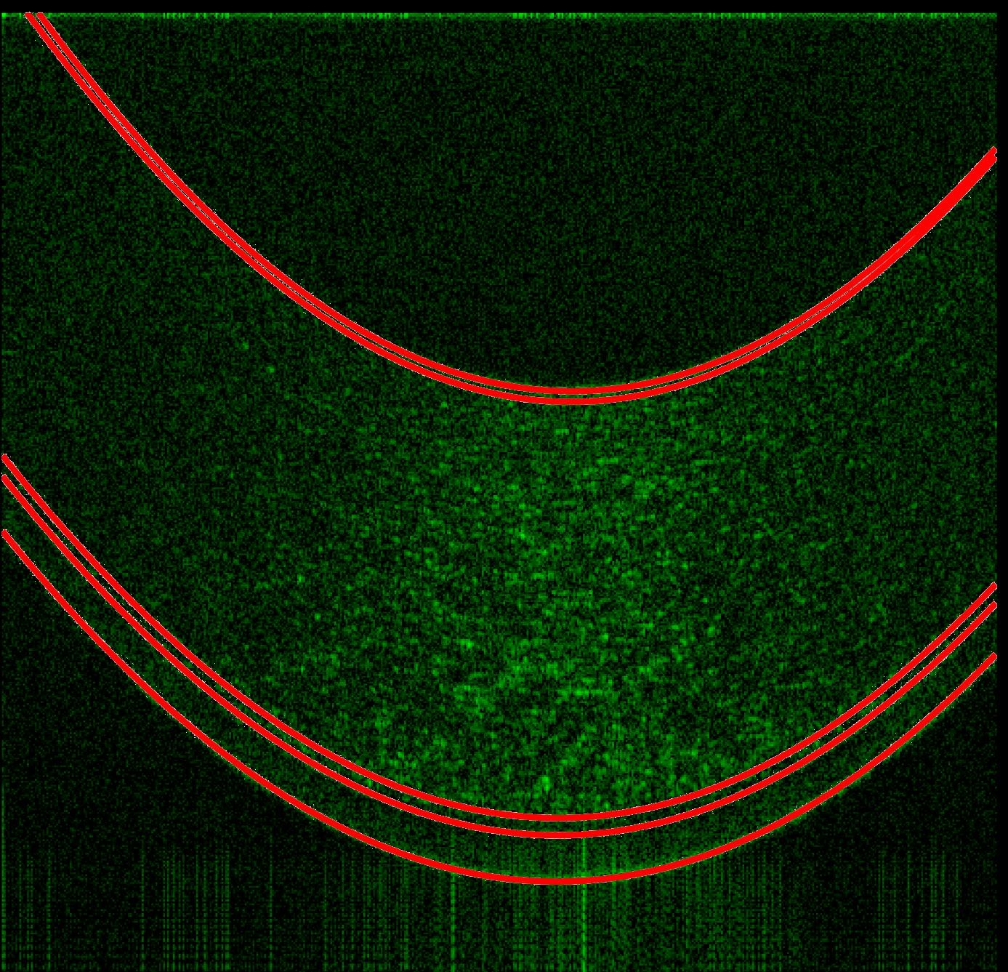
Data Acquisition
Issues
  Low contrast
  Noise
Endothelium
Descemet’s membrane
Stroma
Bowman’s membrane
Epithelium

Slide 5
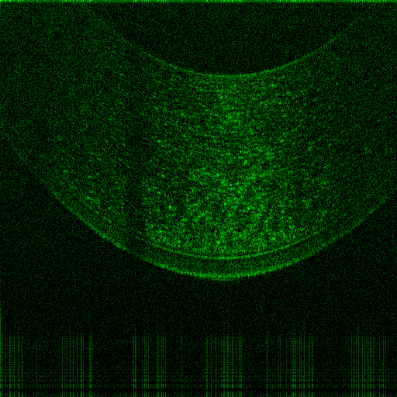
Data Acquisition
Artifacts
  Eye lashes

Slide 6
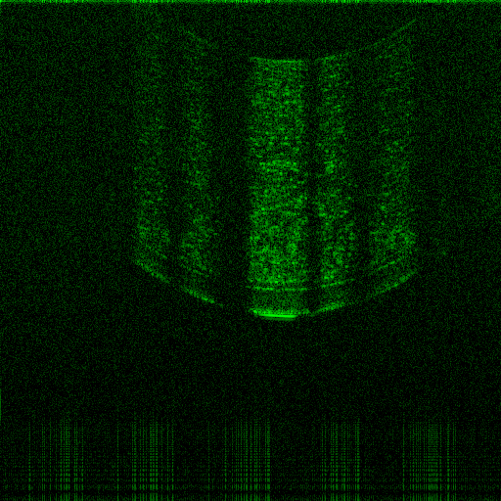
Data Acquisition
Artifacts
  Eye lashes
    Different Eyelashes

Slide 7
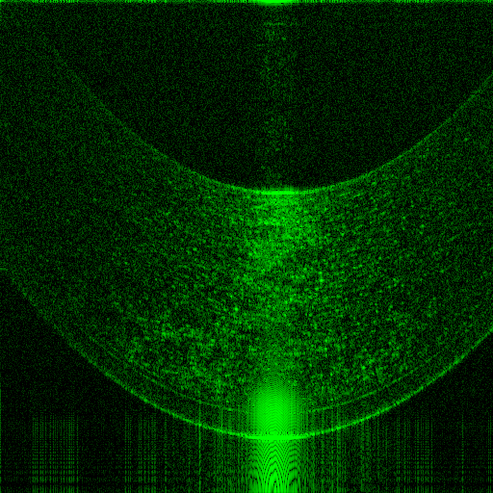
Data Acquisition
Artifacts
  Eye lashes
    Different Eyelashes
    Timing

Slide 8
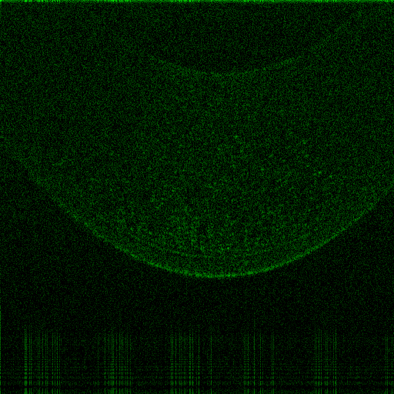
Data Acquisition
Artifacts
  Eye lashes
    Different Eyelashes
    Timing
  Lower Contrast

Slide 9
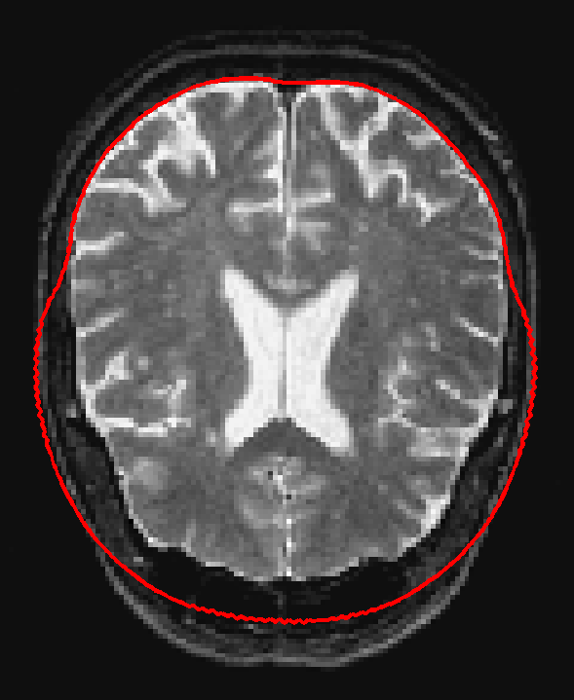
Existing Methods
Active Contours
  Designed to engulf an object
  Gradient information
Parametric Active Contours
Geometric Active Contours
Edge-free Active Contours

Slide 10
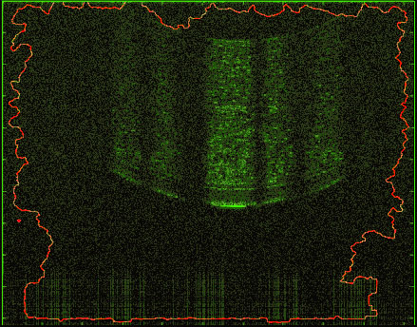
Existing Methods
Active Contours
  Designed to engulf an object
  Gradient information
Parametric Active Contours
Geometric Active Contours
Edge-free Active Contours
Notes:
Level Set with Geometric Active Contours

Slide 11
Existing Methods
Failed
  Noisy image
  Noisy image gradient

Slide 12
Existing Methods
Intelligent Scissors
(Mortenson et al, 1995)
  User guided boundary identification
  Noisy gradient
  Discontinuities due to imaging artifacts

Slide 13
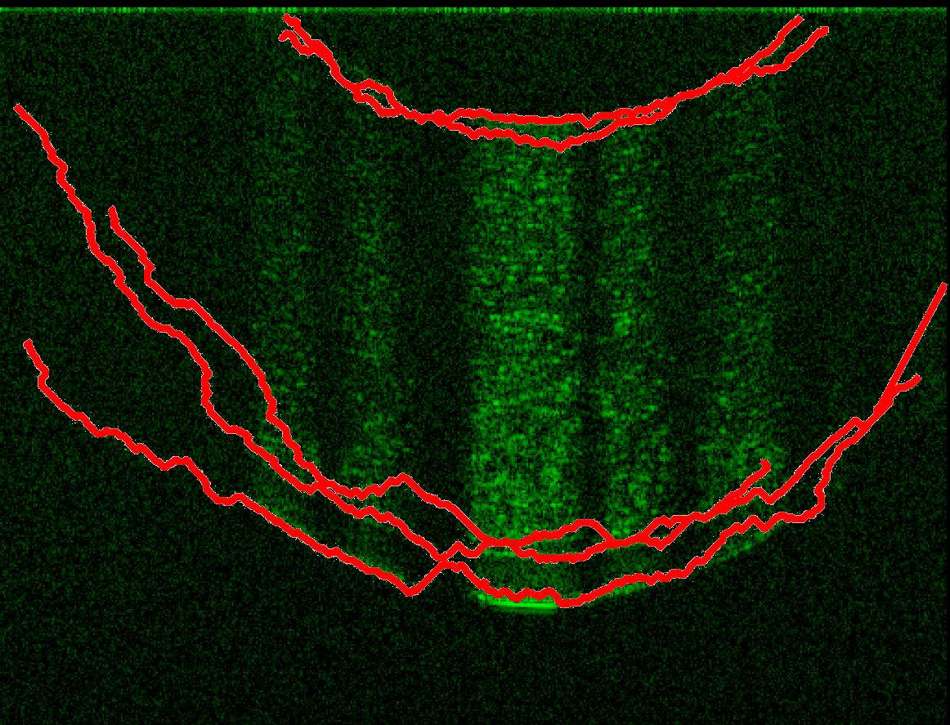
Existing Methods
Intelligent Scissors
(Mortenson et al, 1995)
  User guided boundary identification
  Noisy gradient
  Discontinuities due to imaging artifacts
Unfair example?

Slide 14
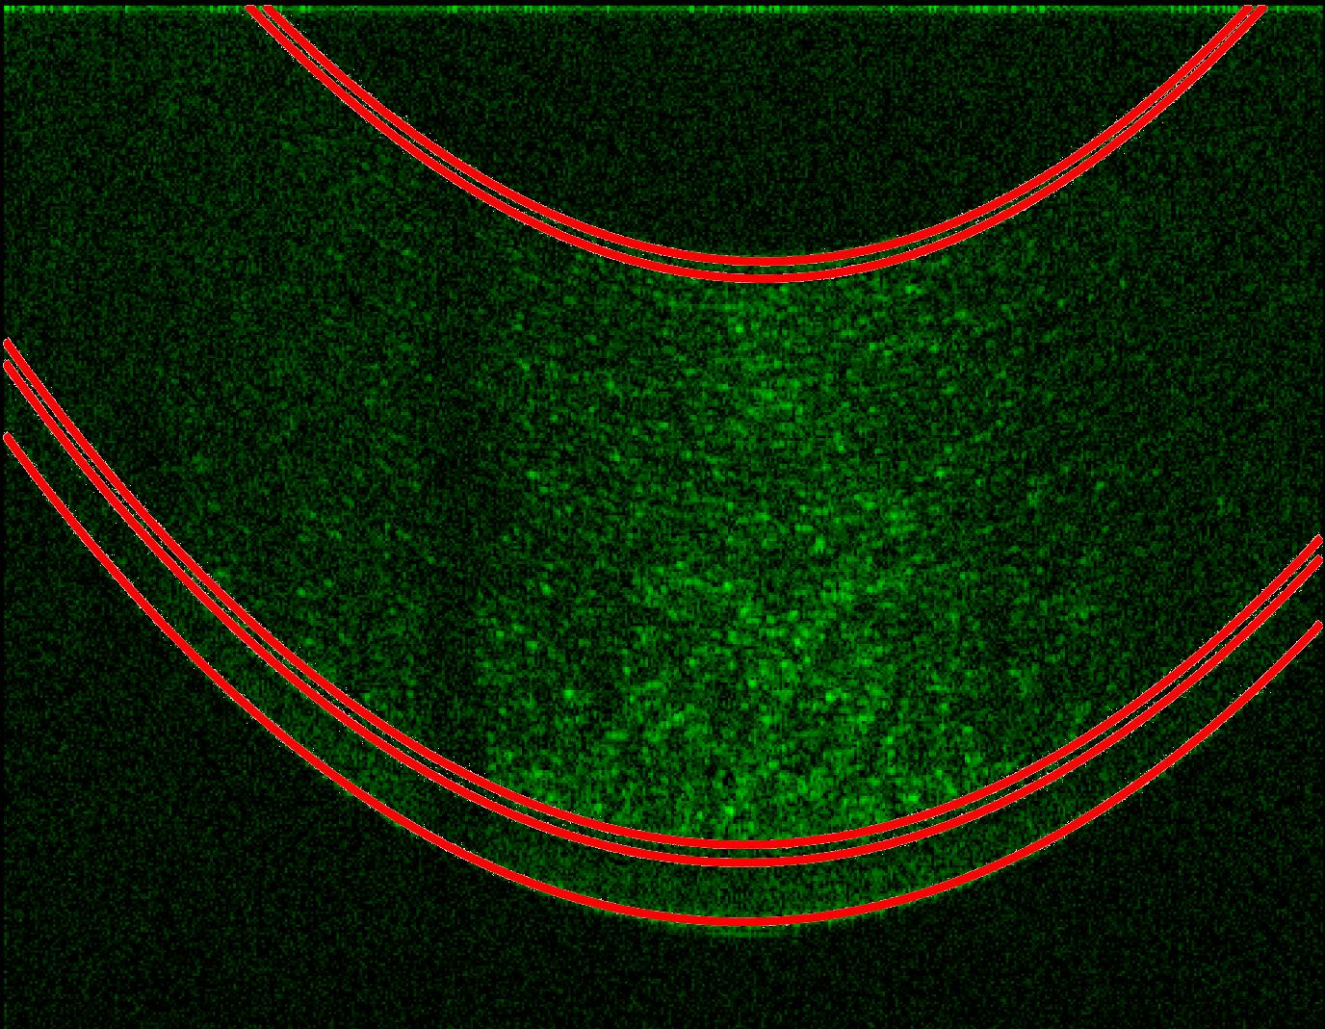
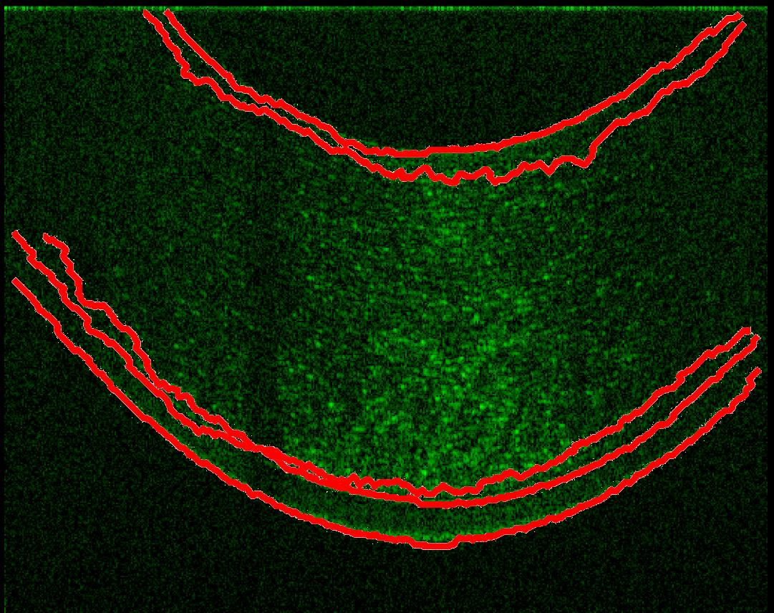
Existing Methods
Few discontinuities
Proposed Method
Intelligent Scissors

Slide 15
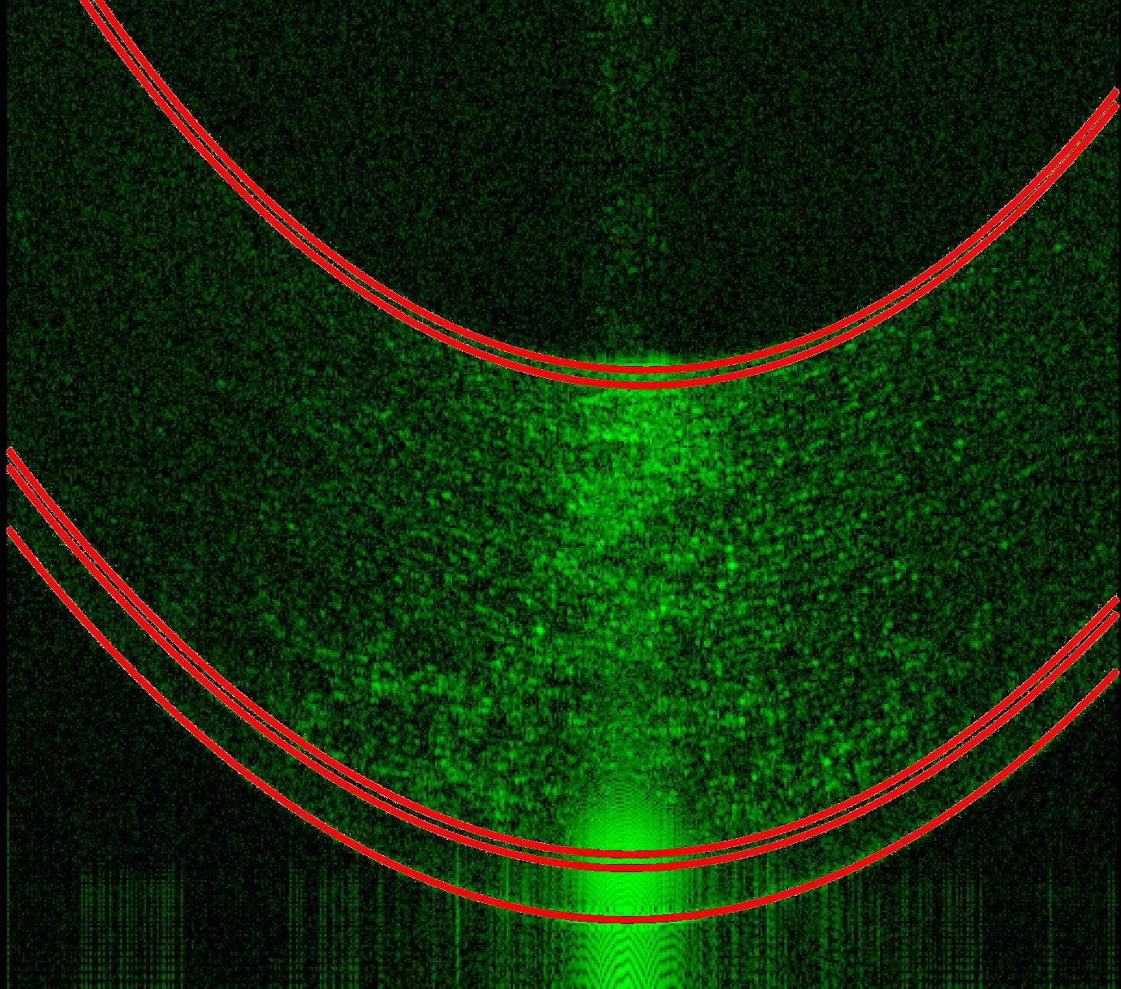
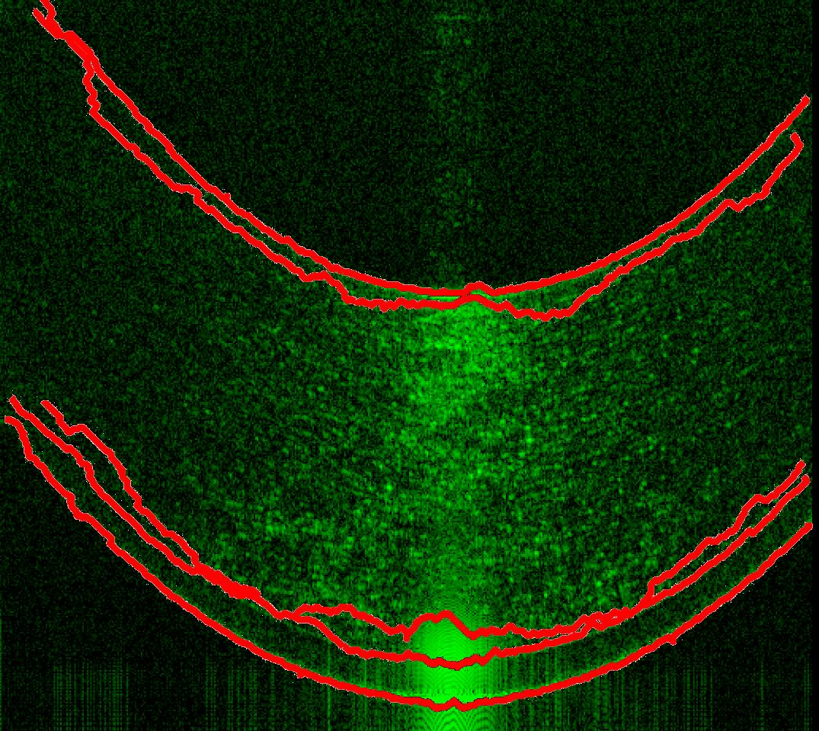
Existing Methods
With artifact
Proposed Method
Intelligent Scissors

Slide 16
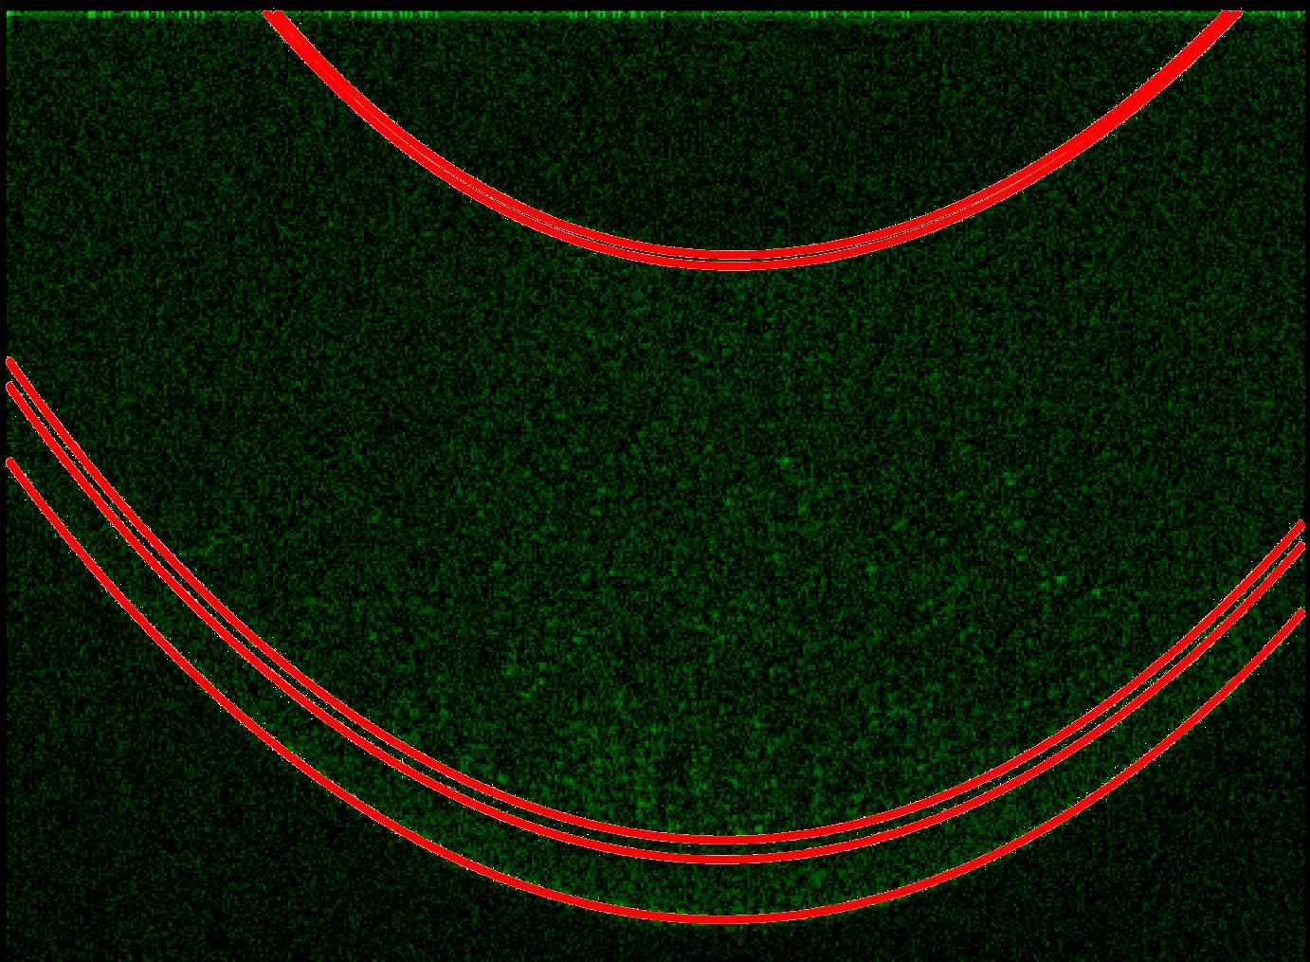
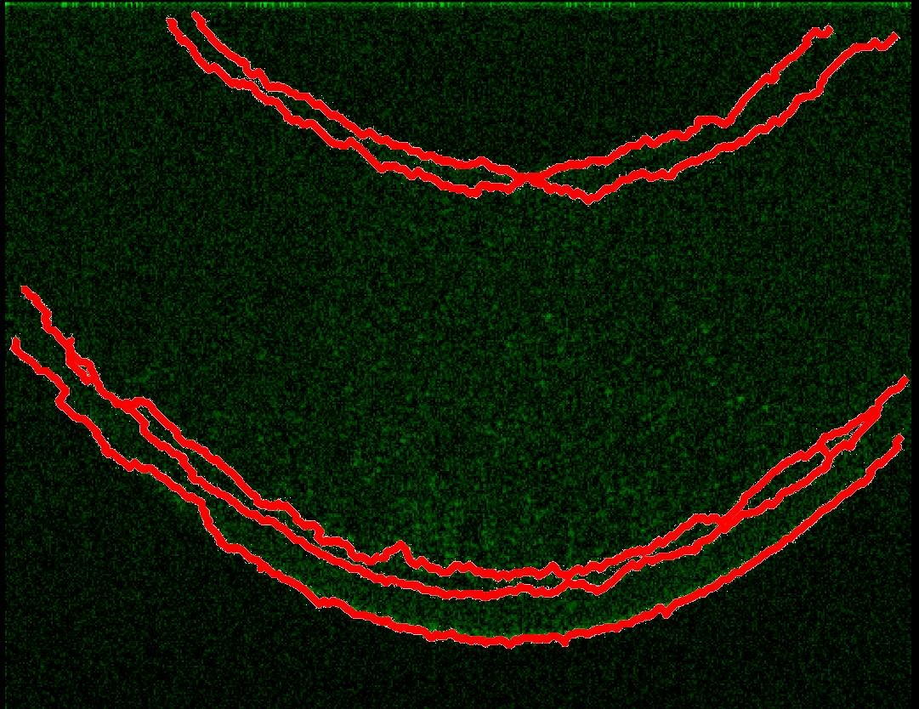
Existing Methods
Low contrast image
Proposed Method
Intelligent Scissors

Slide 17
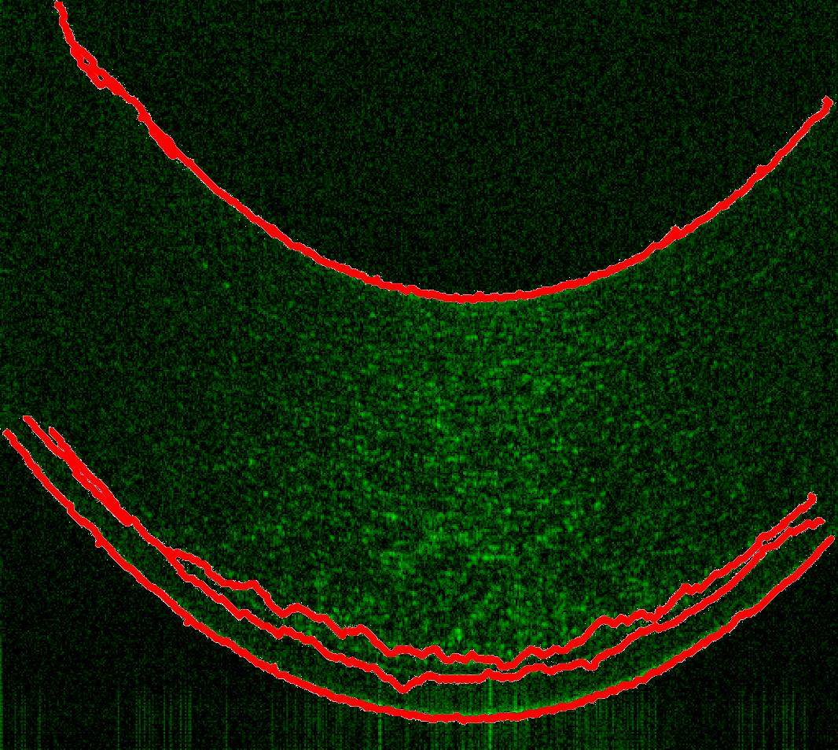
Existing Methods
Well conditioned image
Proposed Method
Intelligent Scissors

Slide 18
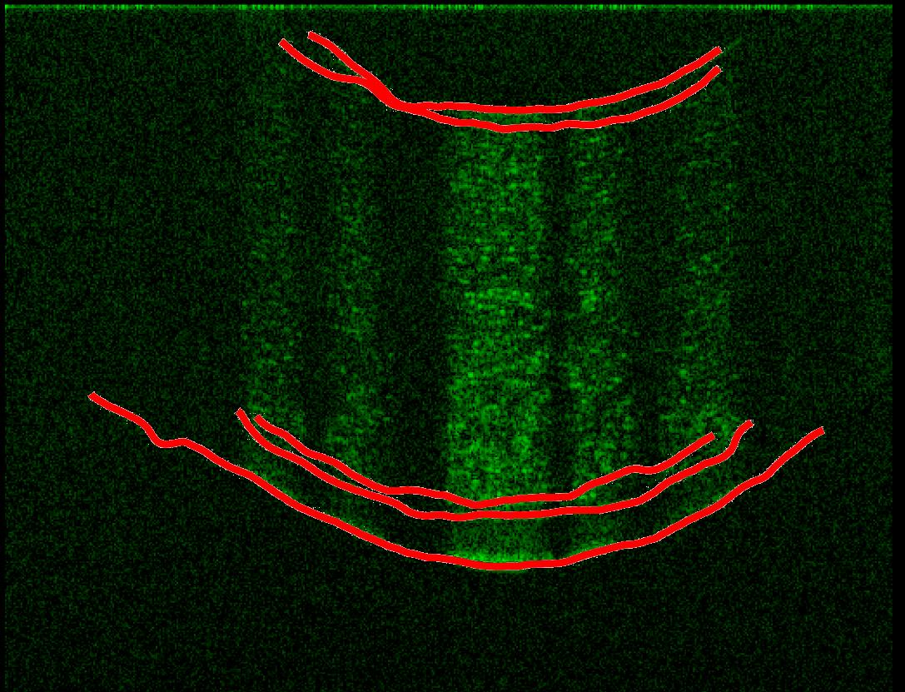
Existing Methods
Enhanced Intelligent Scissors
(Mishra et al, 2008)
  Better than Intelligent Scissors
  User guided boundary identification
  Noisy gradient
  Discontinuities due to imaging artifacts
Better for upper and lower curves
Still not great for inner curves

Slide 19
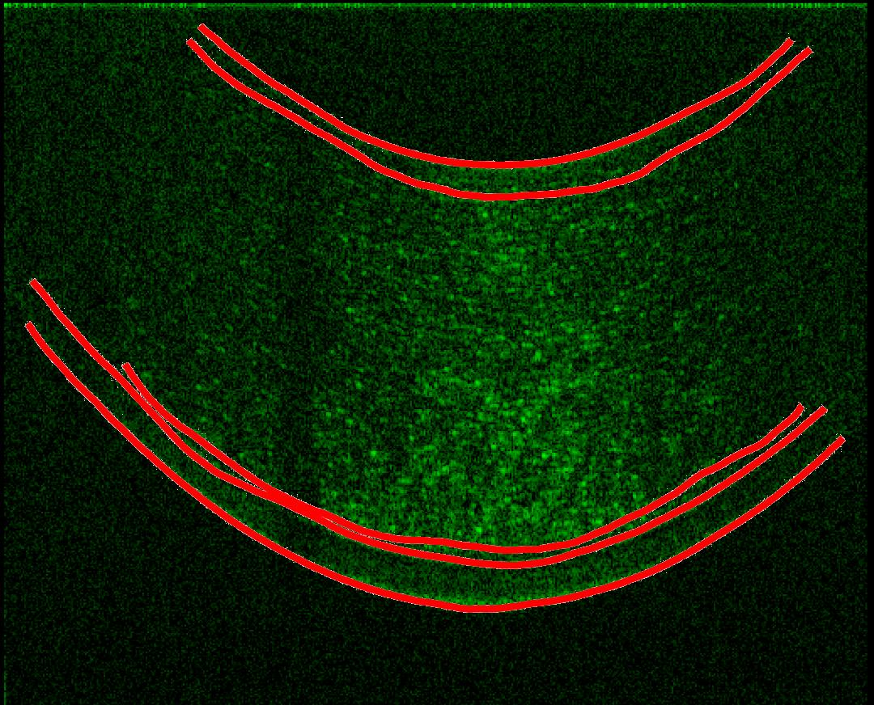
Existing Methods
Few discontinuities
Source
Enhanced Intelligent Scissors

Slide 20
Existing Methods
With artifact
Source
Enhanced Intelligent Scissors

Slide 21
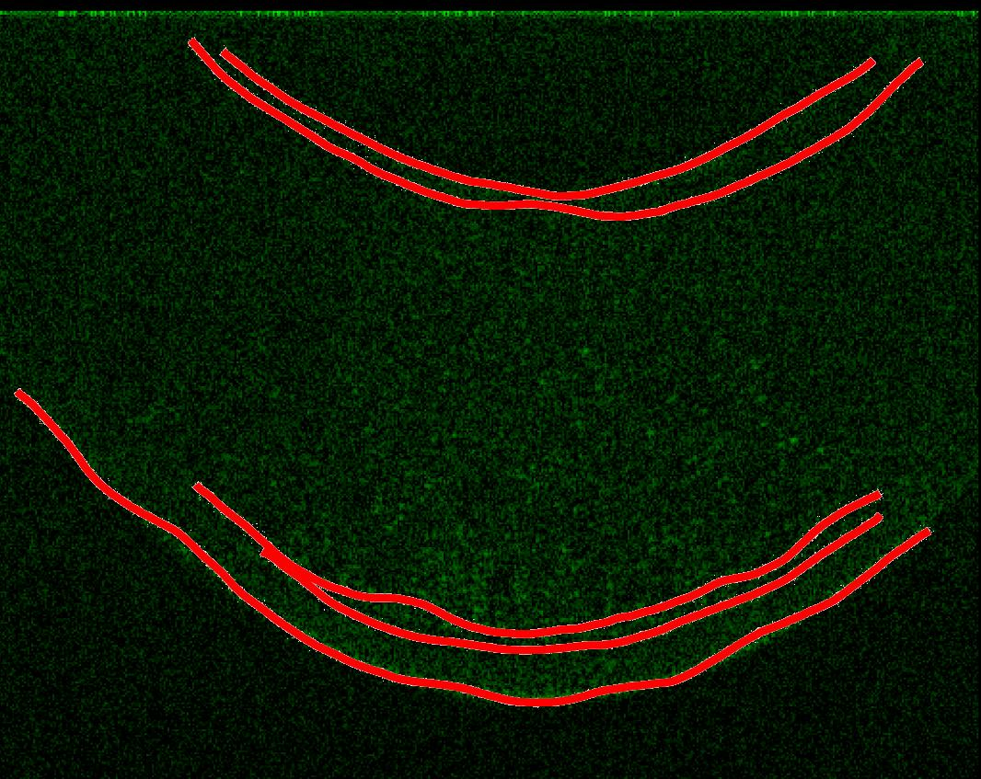
Existing Methods
Low contrast image
Source
Enhanced Intelligent Scissors

Slide 22
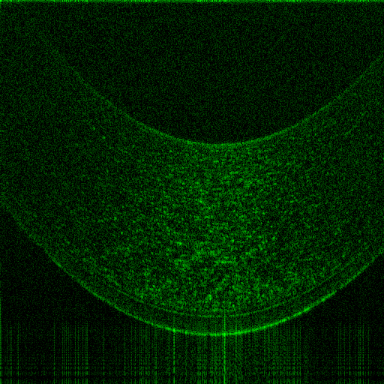
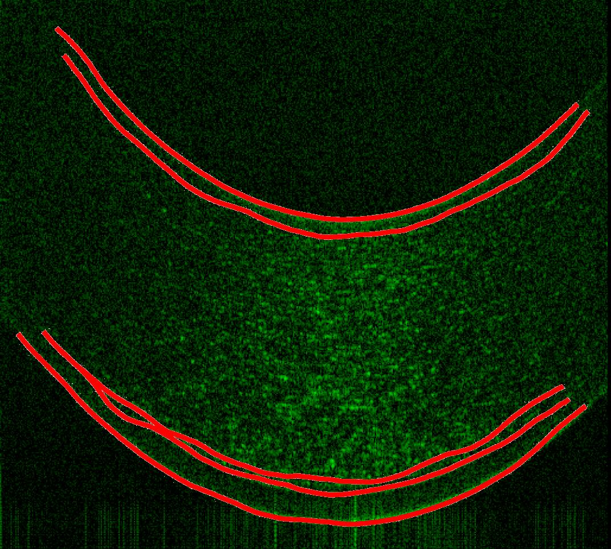
Existing Methods
Well conditioned image
Source
Enhanced Intelligent Scissors

Slide 23
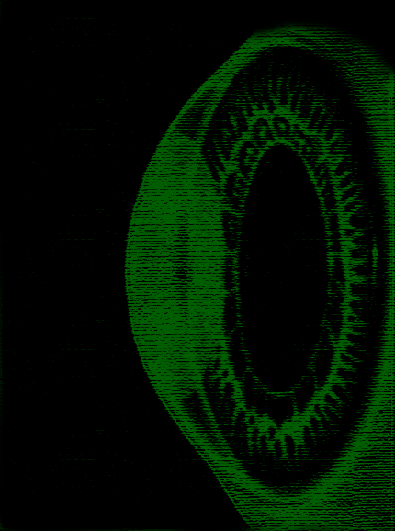
Proposed Method
Semi-automated boundary identification
  Identify high contrast outer boundaries
  Develop model of cornea
  Parameter estimation
  Local optimization

Slide 24
Proposed Method
Well conditioned image
Close up of source
Notes:
Draw on blackboard

Slide 25
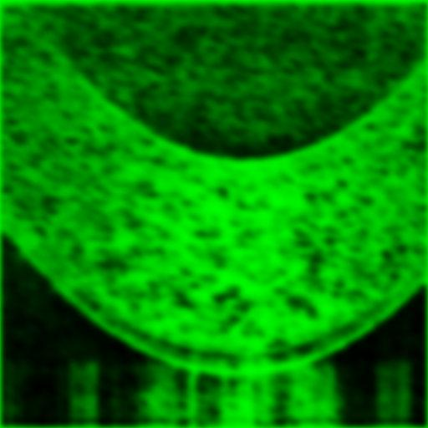
Proposed Method
Preprocessing
  Create a smooth gradient
  Morphological operators
    Set of structuring elements to enhance the arch
    Creates higher contrast upper and lower curves
  Blur to reduce noise

Slide 26
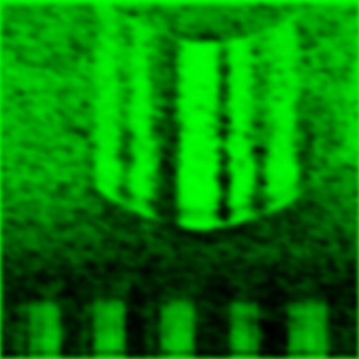
Proposed Method
Many discontinuities
Source
Preprocessed image

Slide 27
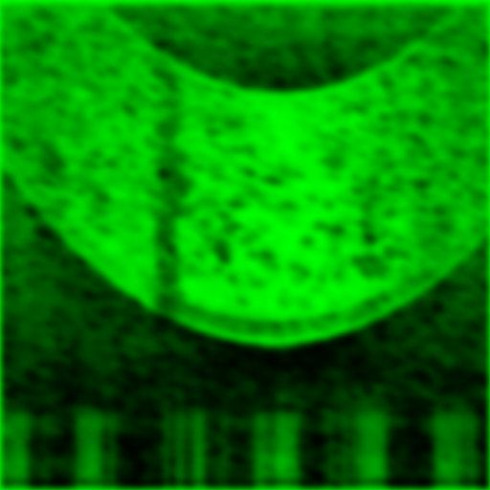
Proposed Method
Few discontinuities
Source
Preprocessed image

Slide 28
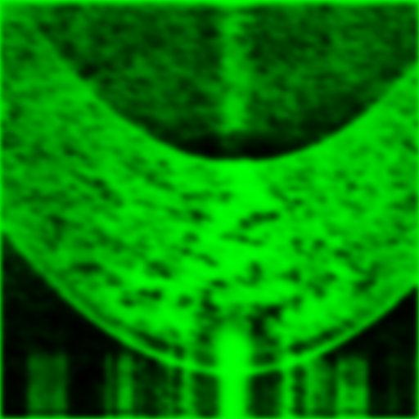
Existing Methods
With artifact
Source
Preprocessed image

Slide 29
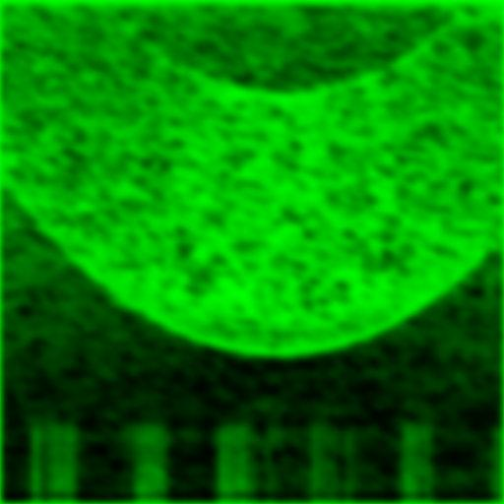
Existing Methods
Low contrast image
Source
Preprocessed image

Slide 30
Existing Methods
Well conditioned image
Source
Preprocessed image

Slide 31
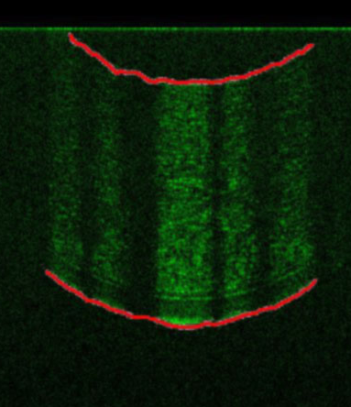
Proposed Method
User input
  Enhanced Intelligent Scissors
  2 points on upper curve
  2 points on lower curve
User input

Slide 32
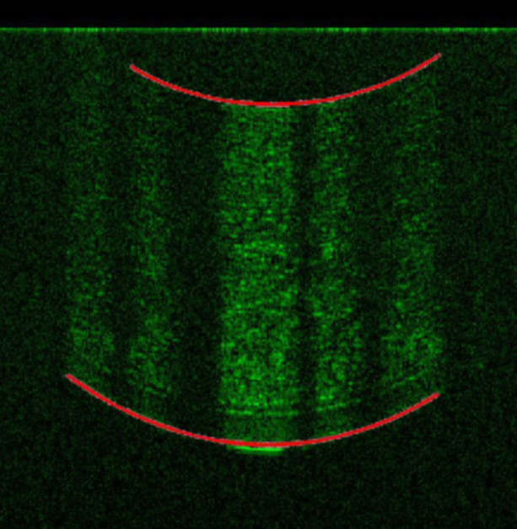
Proposed Method
User input
  Enhanced Intelligent Scissors
  2 points on upper curve
  2 points on lower curve
Fit data to polynomial
  >250 data points
  4th order polynomial
  filters “sloppy input”
Polynomial fitting

Slide 33
Proposed Method
User input
  Enhanced Intelligent Scissors
  2 points on upper curve
  2 points on lower curve
Fit data to polynomial
  >250 data points
  4th order polynomial
  filters “sloppy input”
Polynomial fitting

Slide 34
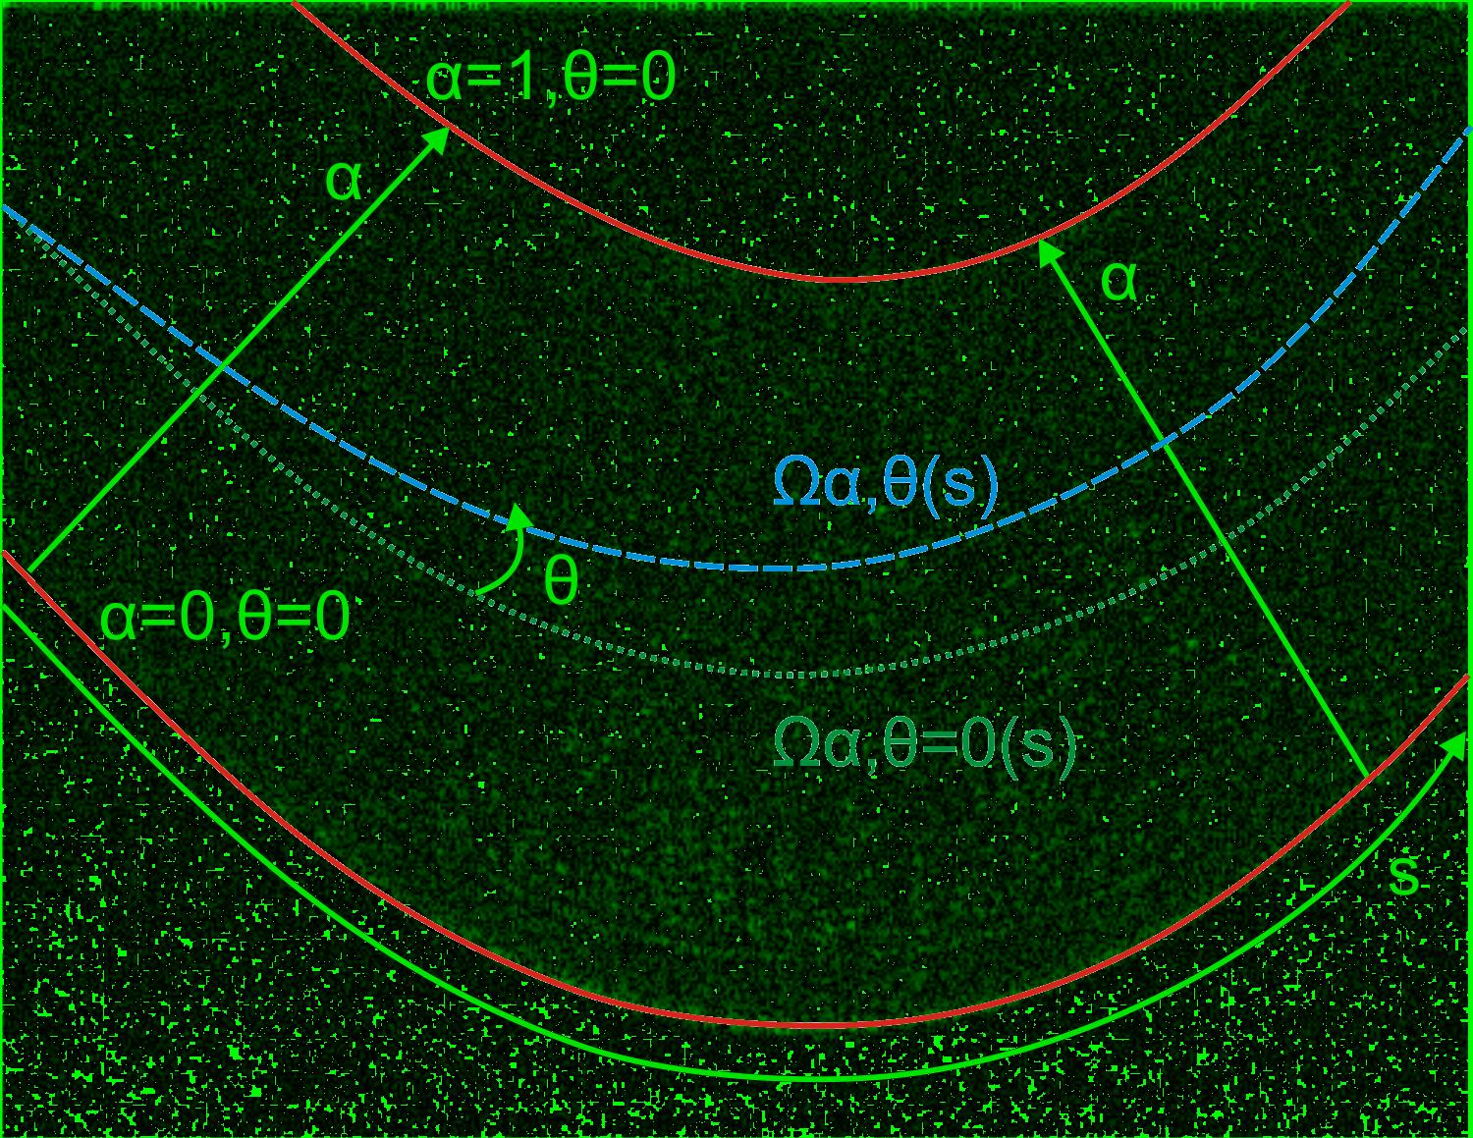
Proposed Method
Corneal Model
  Shortest distance between curves
    medial axis transform
  Define alpha, s, theta, and Omega
Let’s have a closer look

Slide 35
Existing Methods
Source

Slide 36
Proposed Method
Parameter Estimation
  Find inner curves
  Modify alpha and theta to generate search path Omega
  Look at points in the neighborhood of the path

Slide 37
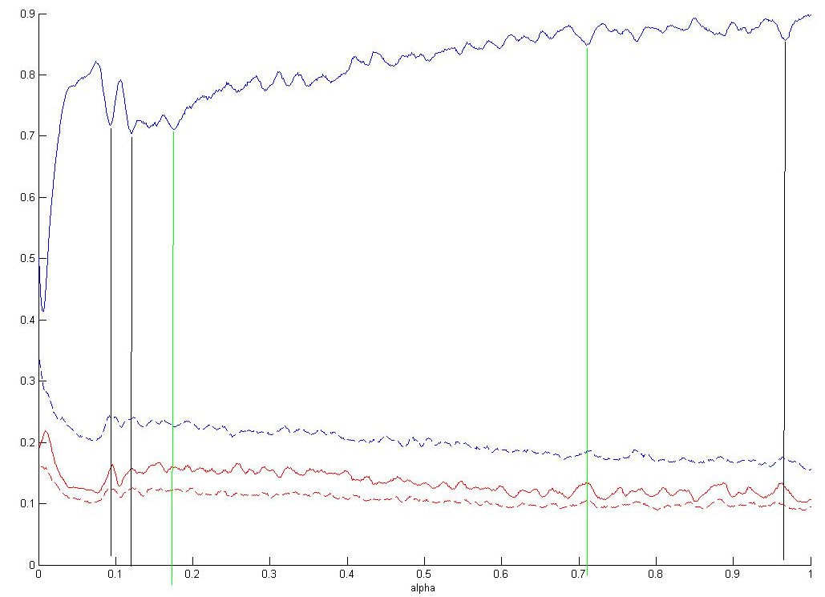
Proposed Method

Slide 38
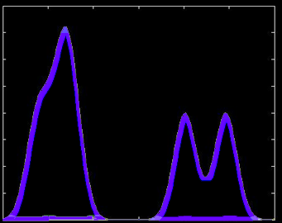
Proposed Method
Parameter Estimation
  False peaks
  Use a prior knowledge
  Gaussian mixture model
  Use statistics from datasets
0
alpha
1

Slide 39
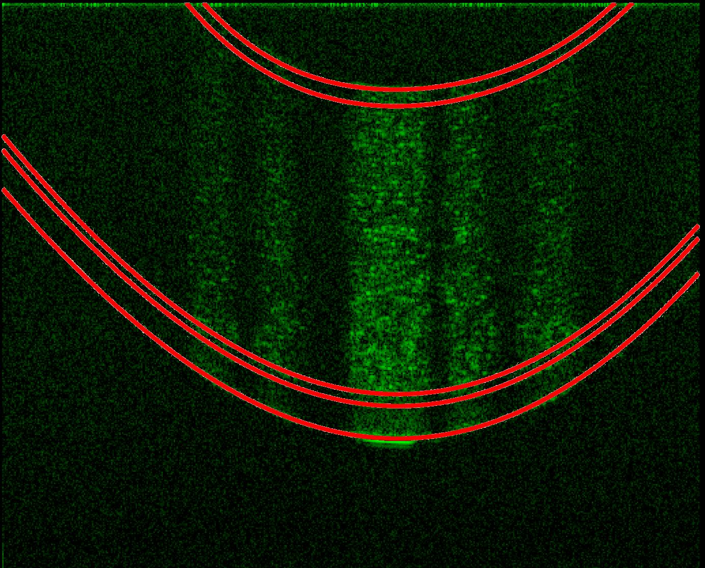
Proposed Method
Parameter Estimation
  Select path with largest difference in intensity
  Keep corresponding values of alpha and theta
Future work
  Currently only focusing on alpha

Slide 40
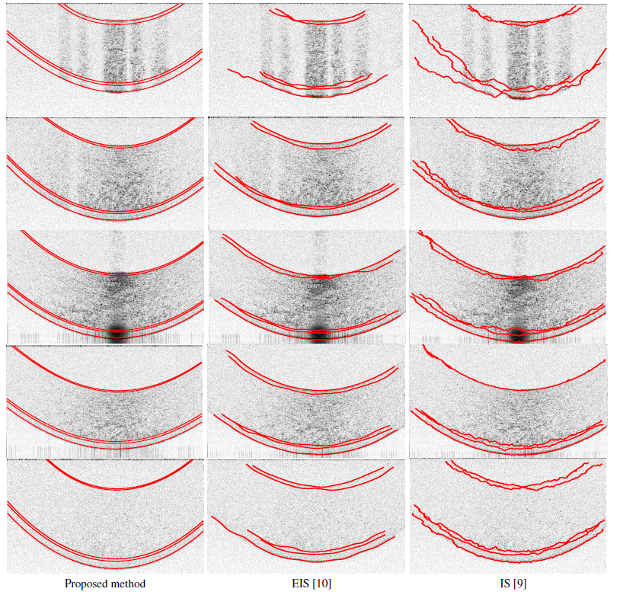
Results

Slide 41
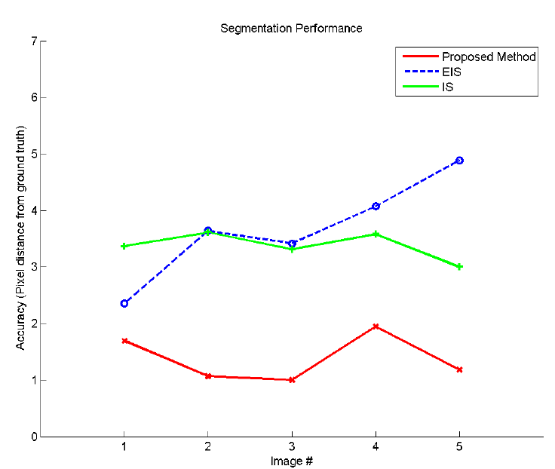
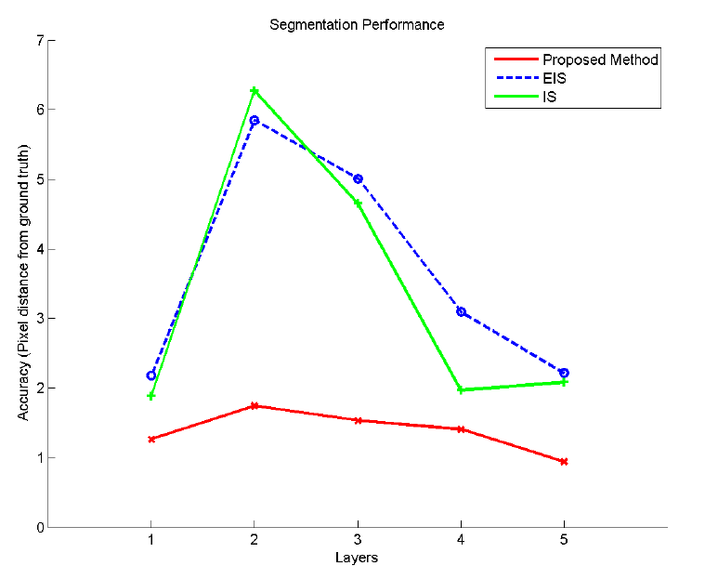
Results

Slide 42
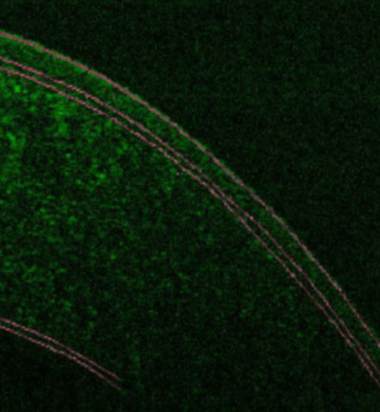
Current Research
  Fully Automated Method
  Local optimization
  Use model to provide initial values for local optimization
  3D reconstruction

Slide 43
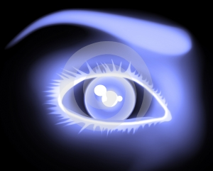
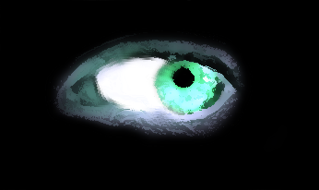
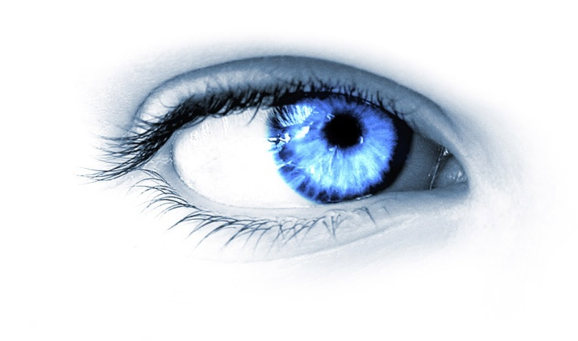
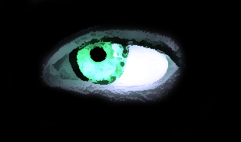
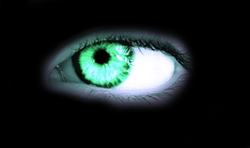
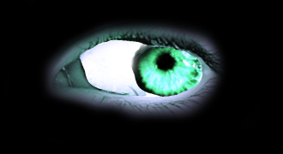
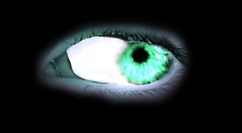
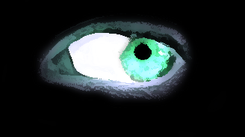
Thank You
Questions?

